Slide 1

School Readiness
How can you best prepare your child for starting school?

Slide 2
What is School Readiness?
School Readiness for EYFS children is defined in terms of the aspects of the school environment that support a smooth transition for children (and their families) into primary school and advance learning for all children.
It is the idea that parents and carers should support a child's growth and development in order to prepare them to start school .
Talking with your child about school and what it will be like would be very beneficial in helping them to prepare for school. Visiting the school and reflecting on what it was like may also be useful for those children who may have anxieties about going to a new place.
Reading books about starting school and listening to children's expectations about school could also help them prepare to make this big change to their routine.

Slide 3
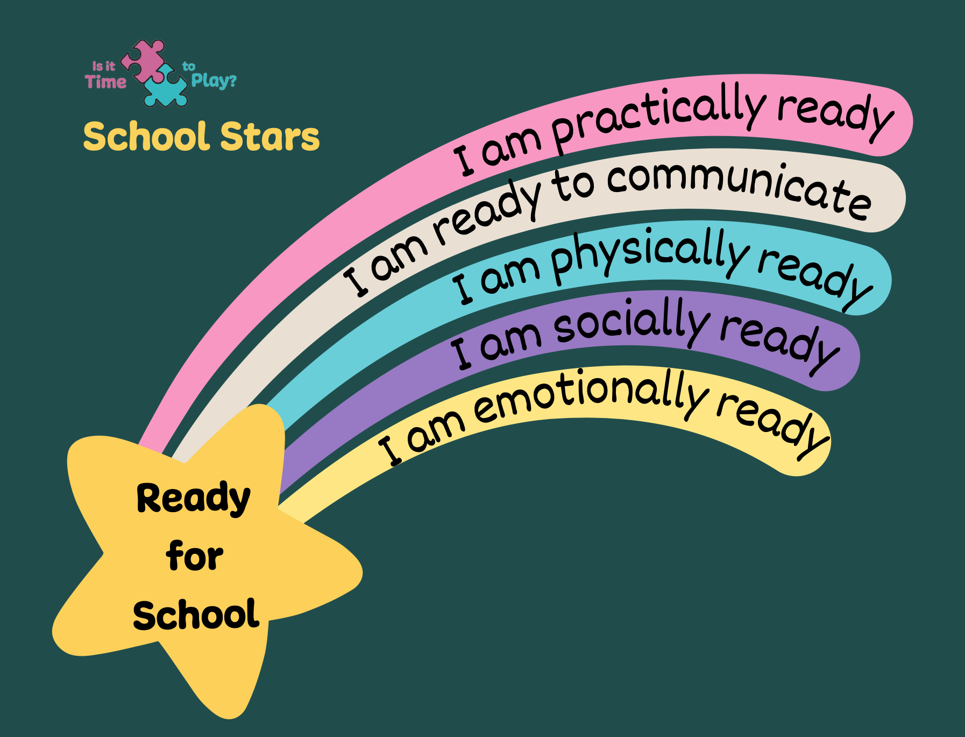
Supporting School Readiness
5 Areas to support School Readiness

Slide 4
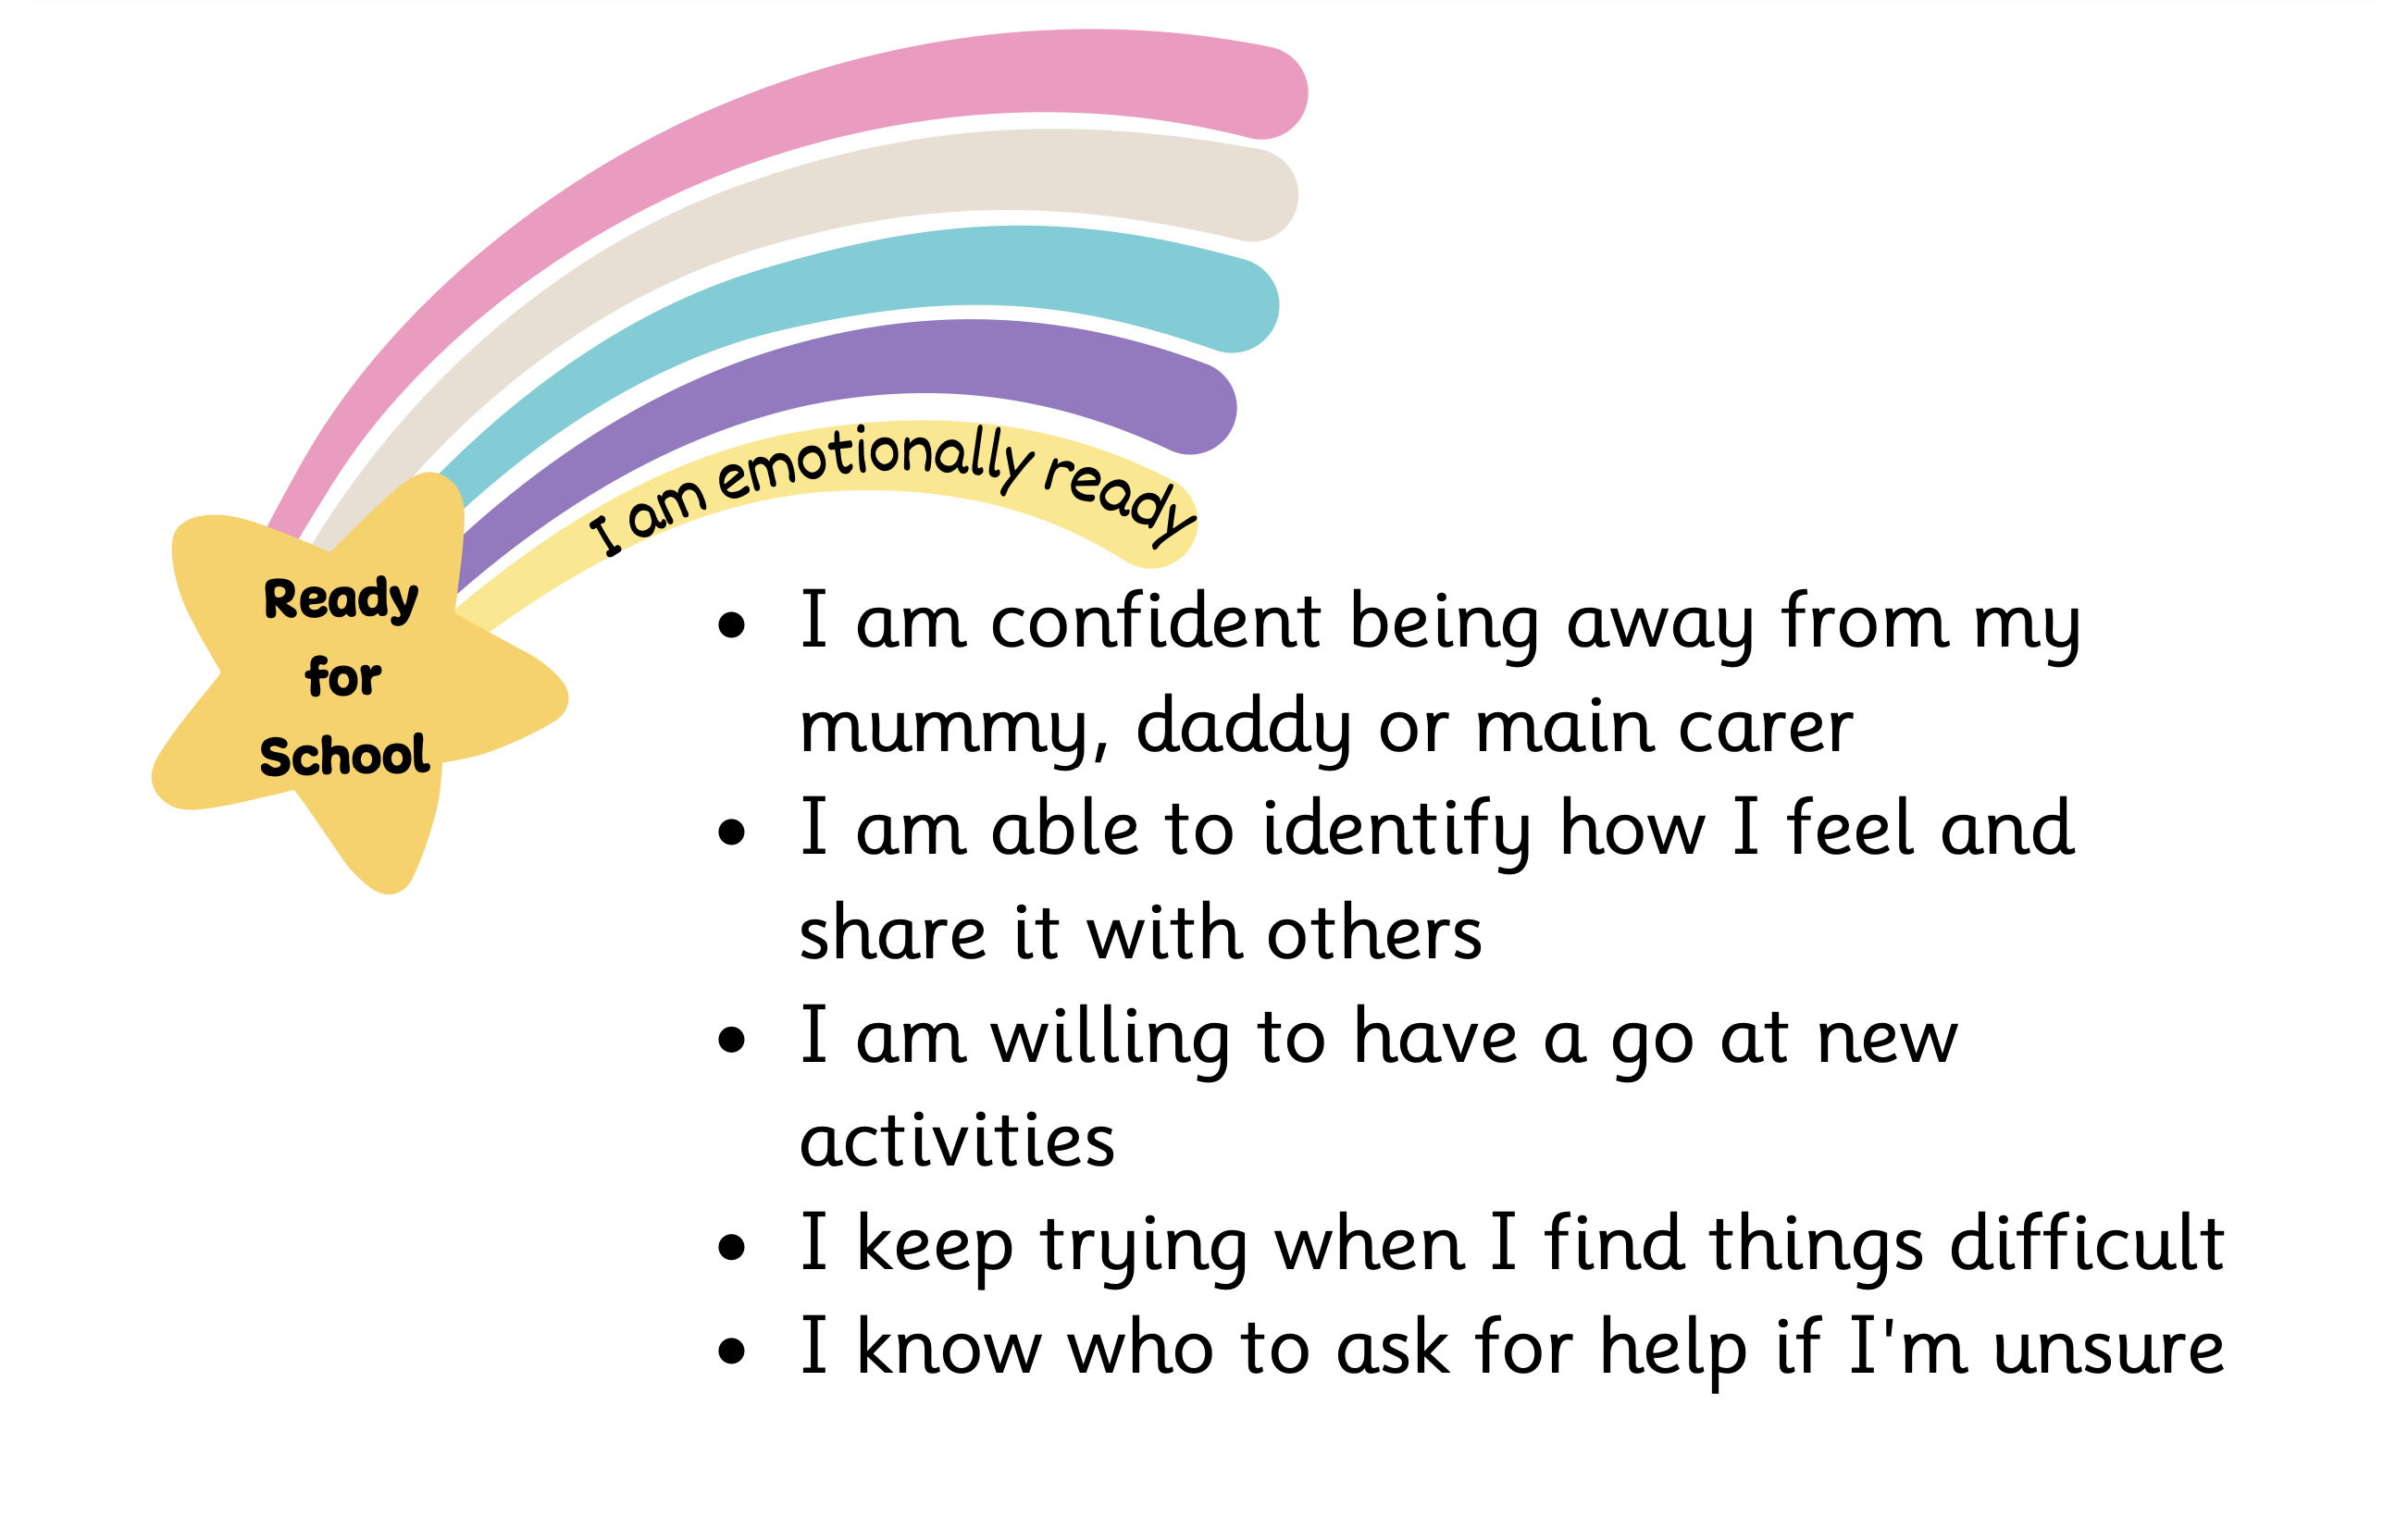

Slide 5
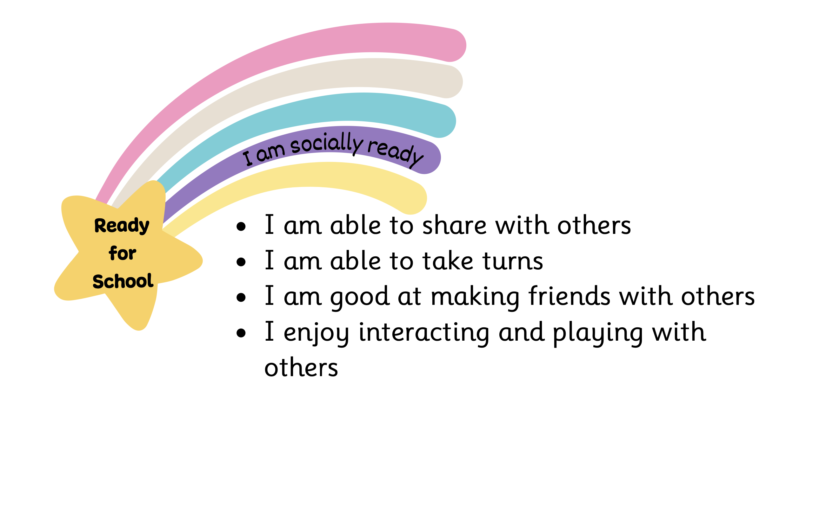

Slide 6
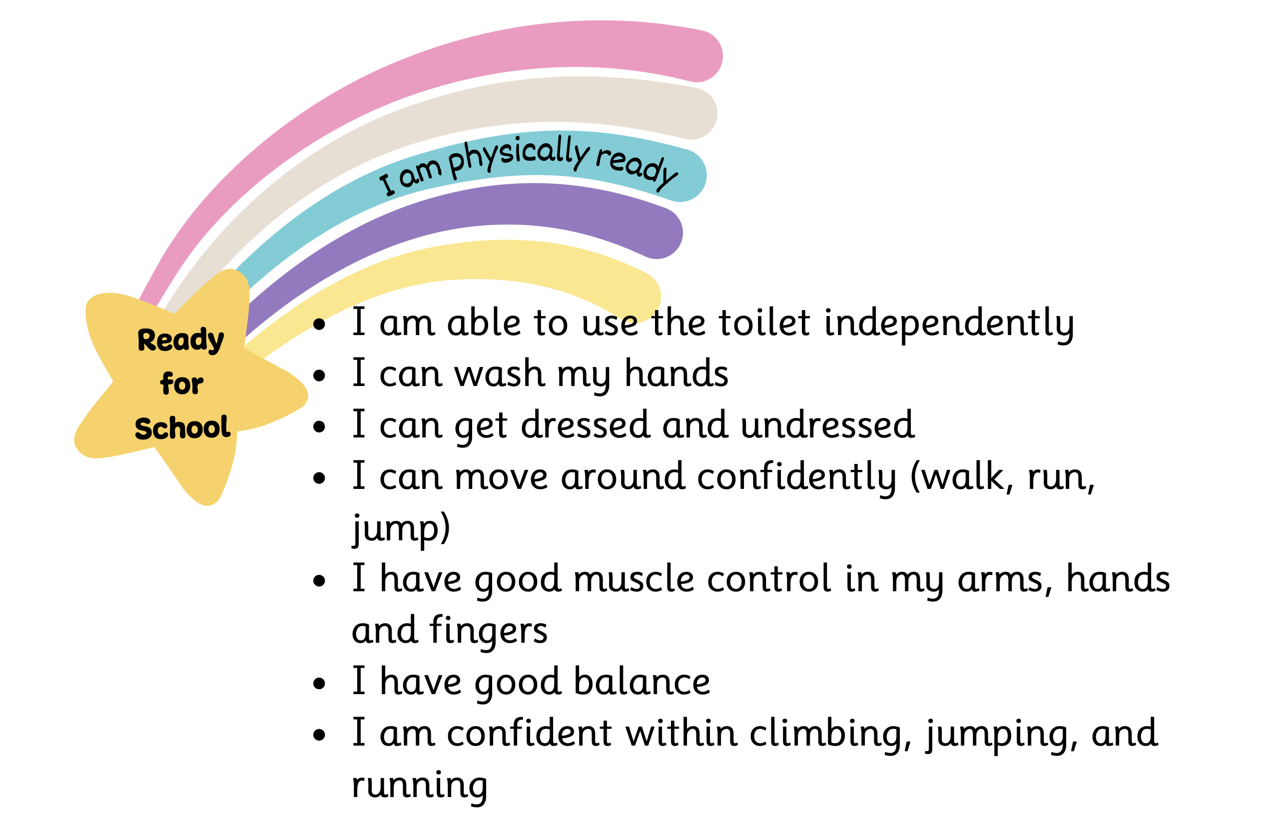

Slide 7
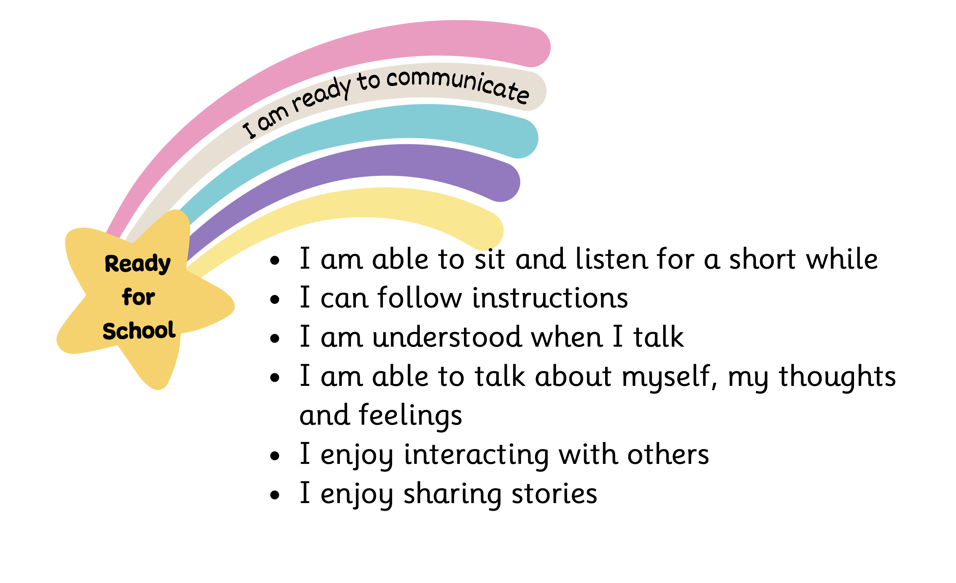

Slide 8
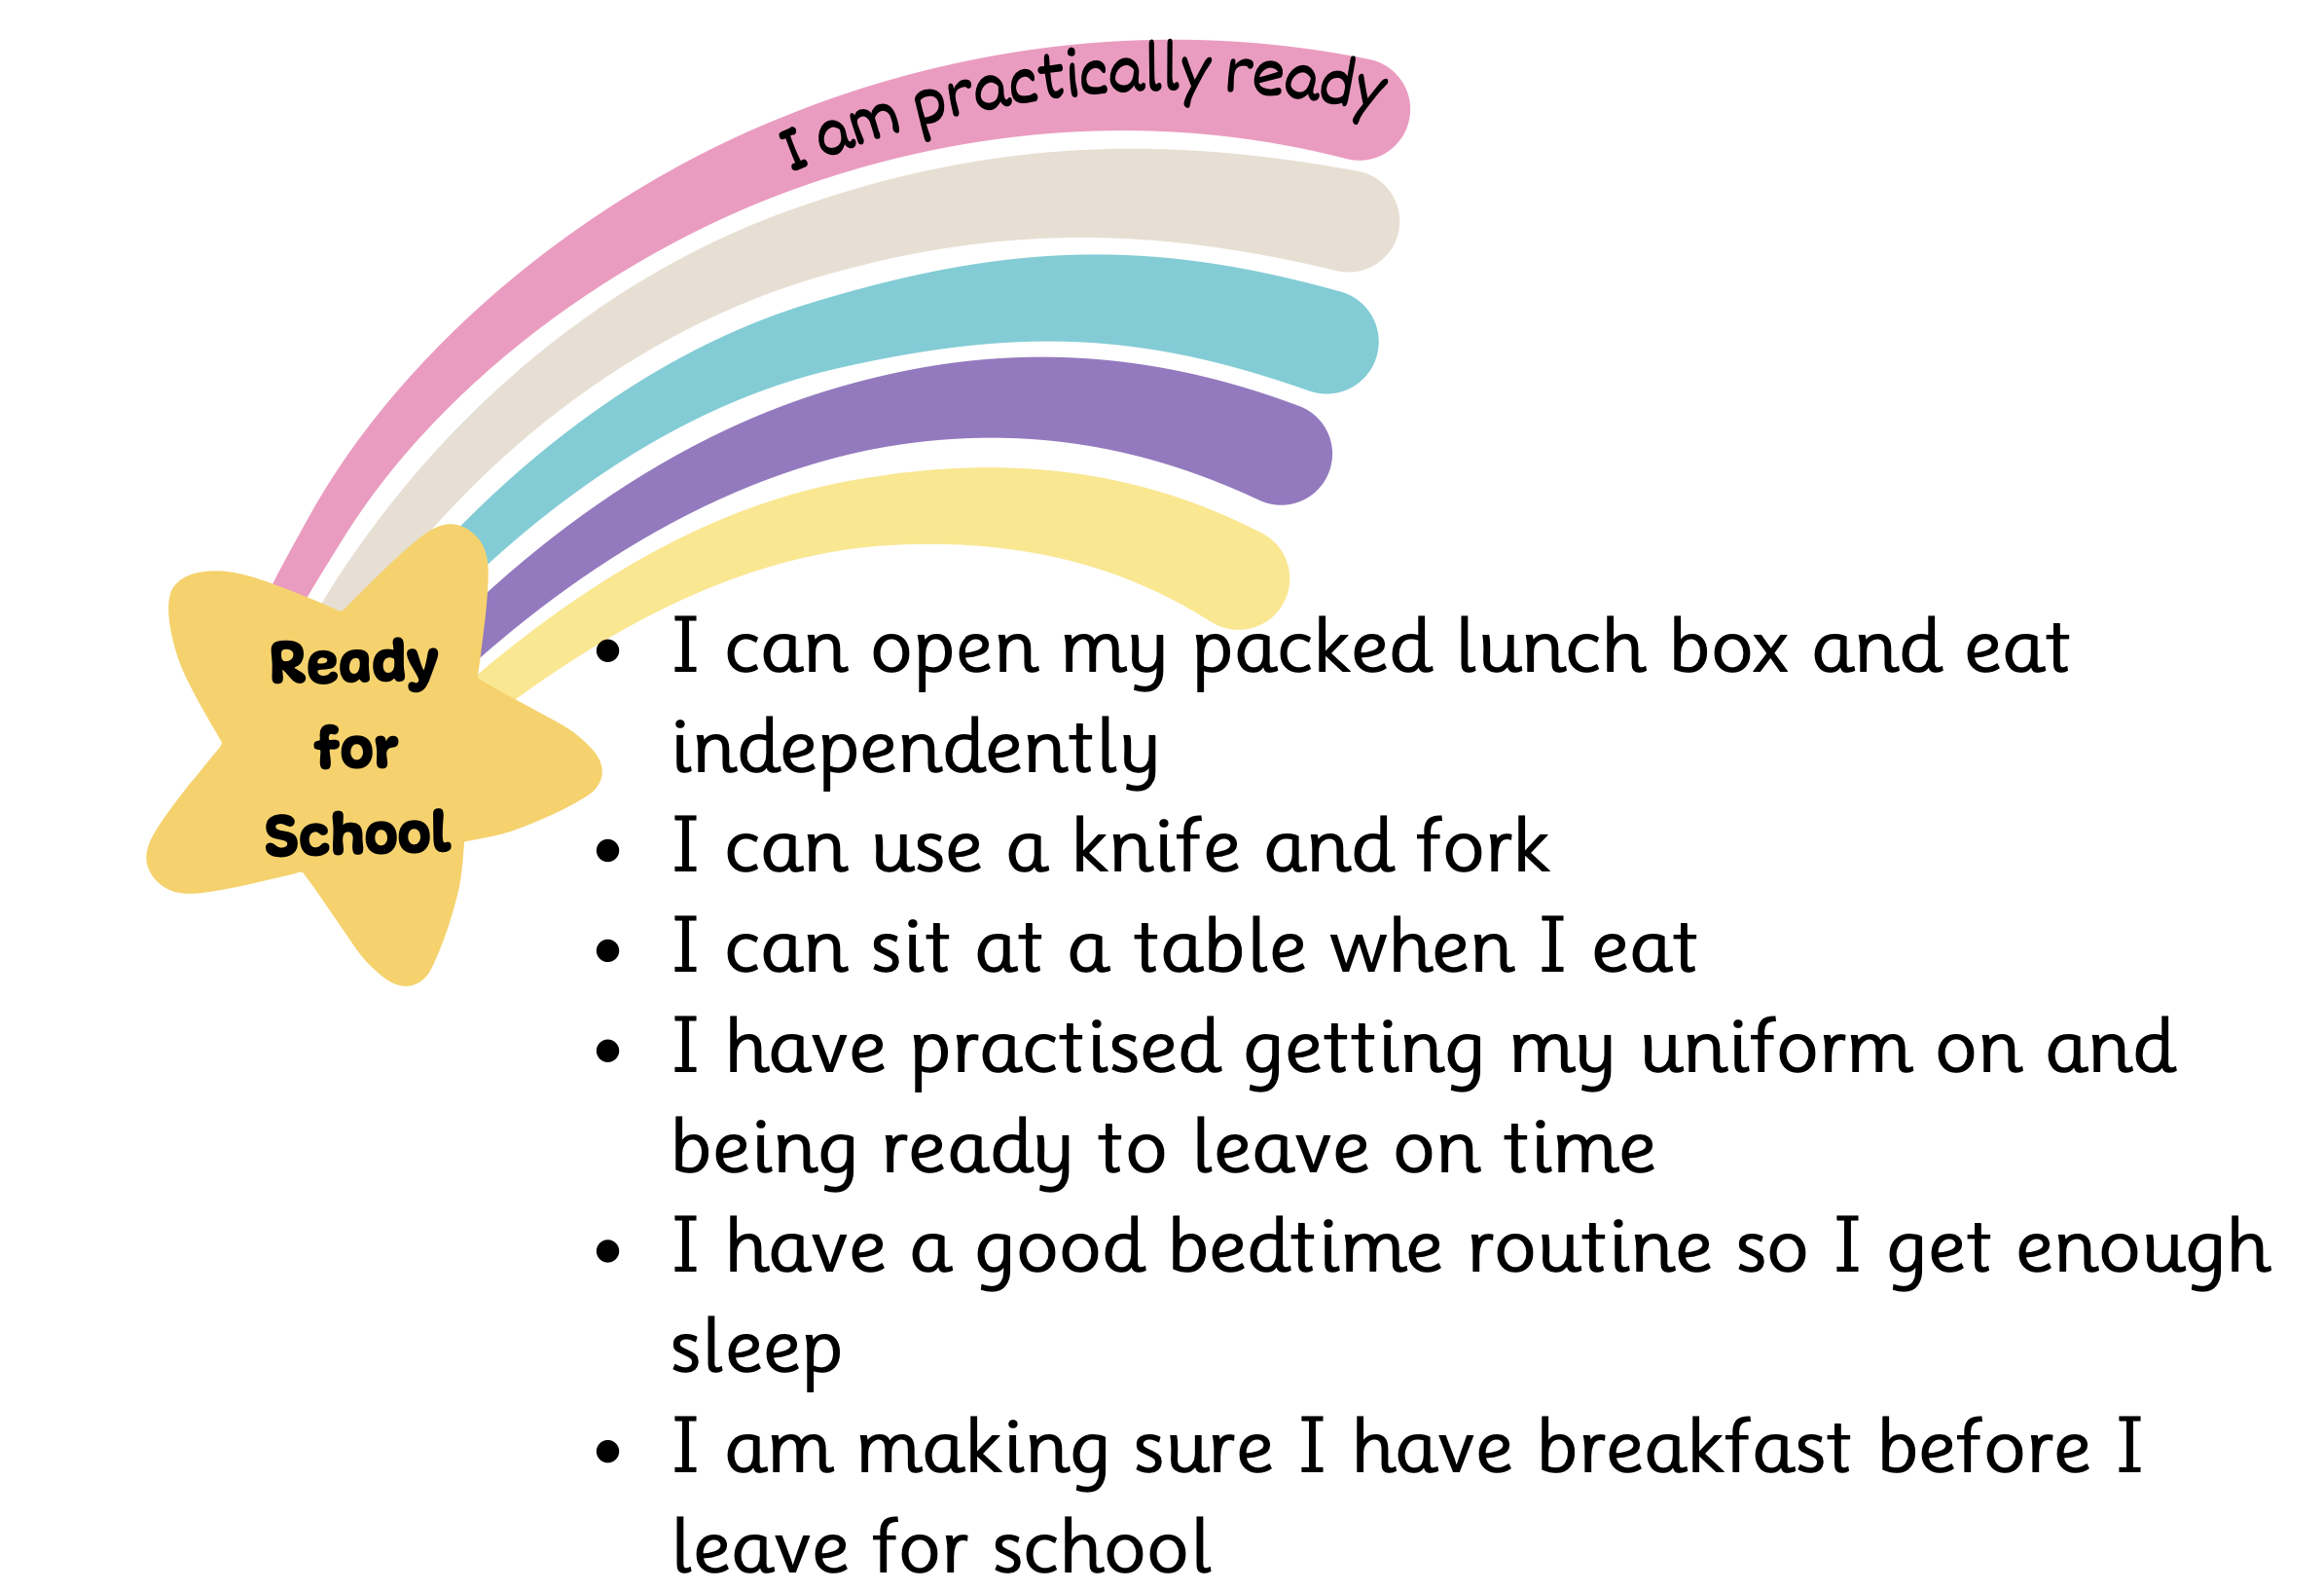

Slide 9
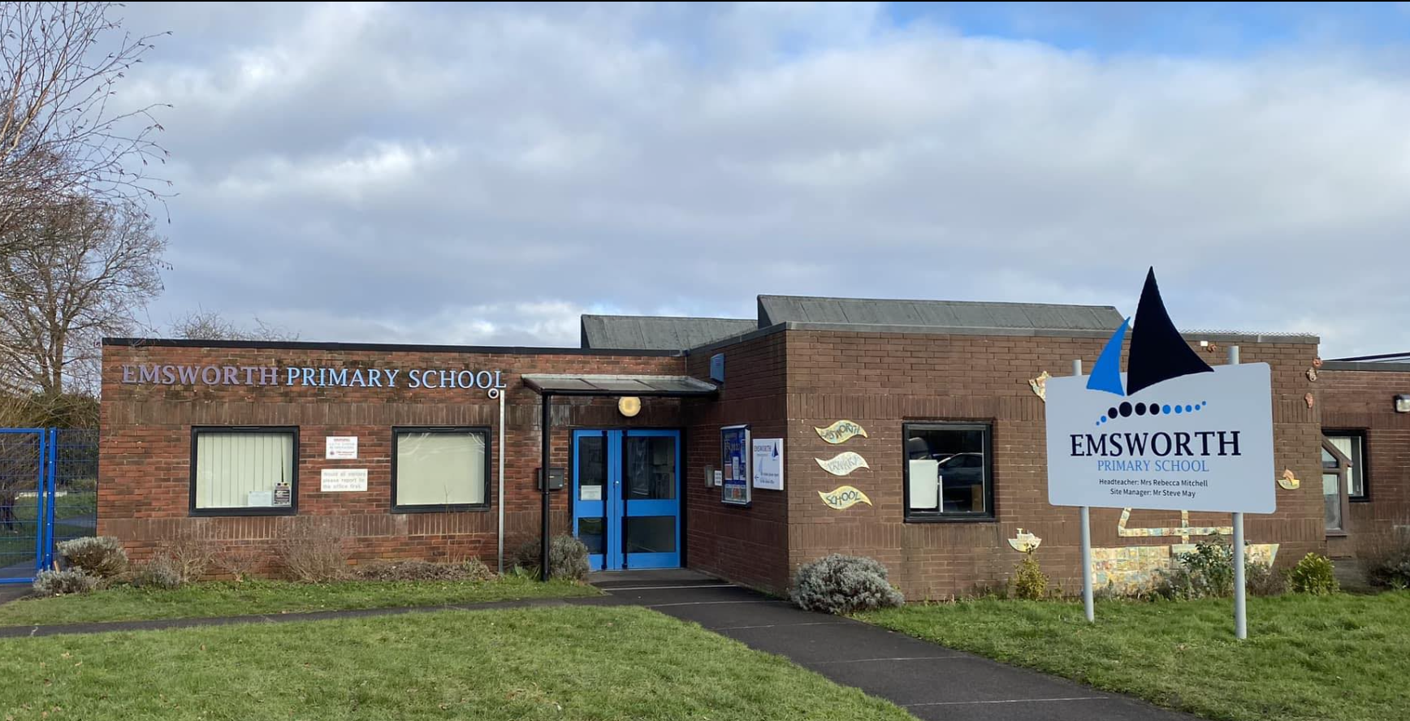
We hope that you have found the school readiness stars useful. Please remember that every child is unique and every child develops at a different pace. These are a guide only and the most important thing is to talk about the important milestone of starting school with your child in a positive way.
Please do not hesitate to contact the school if you have any questions or concerns and we will do
our best to address them.

